Slide 1
Sentiment Analysis Using BERT and Multi-Instance Learning
Iryna Burak
Pablo Restrepo
June 22, 2020

Slide 2
Presentation Overview: What did we do on the last 2 weeks?
Dataset hunting
Exploring our new Amazon reviews dataset in German
Generating embeddings for our new dataset using XLING, XLM and XLM-RoBERTa
Training the network
Plan for the next two weeks
References

Slide 3
Dataset Hunting
The German dataset we were using did not have many reviews in our relevant categories:
We found a new dataset that contains many more reviews in our relevant categories:
Health & Personal Care | 37
Grocery | 2
Beauty | 1
Grocery | 2737
Beauty | 7162

Slide 4
2. Exploring our new Amazon reviews dataset in German
Amazon reviews dataset in German:
200.000 reviews;
31 categories.
Total number of reviews in our relevant categories (Beauty and Grocery): 9.899.
Number of sentences after splitting the comments (using NLTK sent tokenizer): 28.994.

Slide 5
2. Exploring our new Amazon reviews dataset in German
The dataset is balanced:
stars | number of instances
1 | 40000
2 | 40000
3 | 40000
4 | 40000
5 | 40000

Slide 6
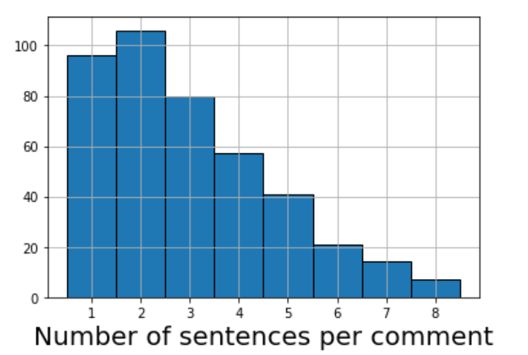
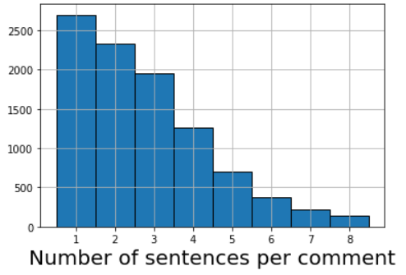
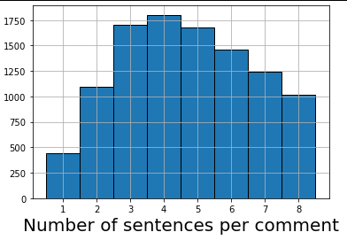
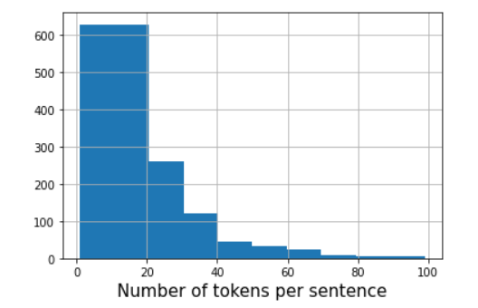
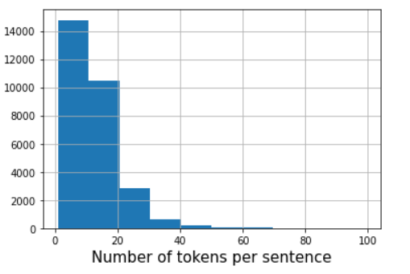
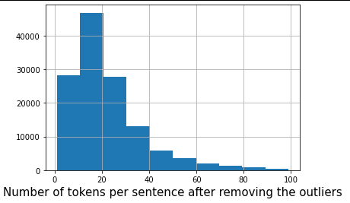
2. Exploring our new Amazon reviews dataset in German
“Old” German Dataset
“New” German Dataset
English Dataset

Slide 7
3. Generating embeddings using XLING, XLM and XLM-RoBERTa
XLING:
Model: universal-sentence-encoder-xling-many (from tfhub)
Embeddings dimensionality: 512
XLM:
Model: xlm-mlm-ende-1024 (XLM Masked language modeling, English-German)(from Huggingface)
Pooling strategy: mean_tokens (not using CLS)
Embeddings dimensionality: 1024
XLM-RoBERTa:
Model: xlm-roberta-base (100 languages)(from Huggingface)
Pooling strategy: mean_tokens (not using CLS)
Embeddings dimensionality: 768

Slide 8
4. Training the network: base BERT
Amazon EN
Without fine-tuning on organic
True | - | 0 | +
- | 71 | 14 | 54
0 | 37 | 10 | 99
+ | 21 | 5 | 162
metric | amazon EN | organic
F1 (micro) | 0.674 | 0.498
F1 (macro) | 0.664 | 0.494
Organic
With fine-tuning on organic
True | - | 0 | +
- | 87 | 38 | 21
0 | 49 | 118 | 32
+ | 19 | 47 | 92
metric | amazon EN | organic
F1 (micro) | 0.514 | 0.594
F1 (macro) | 0.429 | 0.595

Slide 9
4. Training the network: multilingual BERT
Amazon EN
Amazon DE
True | - | 0 | +
- | 26 | 98 | 6
0 | 19 | 114 | 18
+ | 14 | 144 | 41
True | - | 0 | +
- | 2343 | 1758 | 41
0 | 1017 | 960 | 56
+ | 1367 | 2032 | 323
Organic
True | - | 0 | +
- | 69 | 56 | 13
0 | 34 | 149 | 8
+ | 35 | 88 | 56
metric | amazon EN | amazon DE | organic
F1 (micro) | 0.377 | 0.366 | 0.539
F1 (macro) | 0.345 | 0.322 | 0.518

Slide 10
4. Training the network: XLING
Amazon EN
Amazon DE
True | - | 0 | +
- | 41 | 76 | 36
0 | 23 | 77 | 57
+ | 2 | 41 | 131
True | - | 0 | +
- | 1889 | 1639 | 614
0 | 593 | 769 | 671
+ | 274 | 870 | 2578
Organic
True | - | 0 | +
- | 45 | 63 | 23
0 | 26 | 144 | 37
+ | 19 | 50 | 101
metric | amazon EN | amazon DE | organic
F1 (micro) | 0.514 | 0.530 | 0.571
F1 (macro) | 0.490 | 0.506 | 0.546

Slide 11
4. Training the network: XLM-RoBERTa
Amazon EN
Amazon DE
True | - | 0 | +
- | 11 | 117 | 8
0 | 5 | 109 | 23
+ | 4 | 128 | 74
True | - | 0 | +
- | 1270 | 2834 | 38
0 | 595 | 1352 | 86
+ | 328 | 2467 | 927
Organic
True | - | 0 | +
- | 41 | 100 | 7
0 | 12 | 168 | 16
+ | 12 | 91 | 61
metric | amazon EN | amazon DE | organic
F1 (micro) | 0.405 | 0.359 | 0.531
F1 (macro) | 0.354 | 0.367 | 0.494

Slide 12
4. Training the network: XLM
Something is totally wrong!
Amazon EN
without fine-tuning on organic
Amazon EN
with fine-tuning on organic
True | - | 0 | +
- | 0 | 0 | 111
0 | 0 | 2 | 160
+ | 0 | 3 | 204
True | - | 0 | +
- | 0 | 111 | 0
0 | 0 | 162 | 0
+ | 0 | 207 | 0

Slide 13
5. Plan for the next two weeks
Investigate the issue with XLM embeddings.
Fine-tune our models.
Improve the baselines.

Slide 14
6. References
M. Chidambaram, Y. Yang, D. Cer, S. Yuan, Y.-H. Sung, B. Strope, and R. Kurzweil. Learning Cross-Lingual Sentence Representations via a Multi-task Dual-Encoder Model. ArXiv e-prints, October 2018.
universal-sentence-encoder-xling-many, Google,https://tfhub.dev/google/universal-sentence-encoder-xling-many/1
arxiv2018-xling-sentence-embeddings, UKPLab, https://github.com/UKPLab/arxiv2018-xling-sentence-embeddings
Multi-lingual models, Huggingface, https://huggingface.co/transformers/multilingual.html

